Slide 1
Software Project Management

Slide 2
Introduction
What does Plan-and-Document do instead of
User stories?
Points?
Velocity?
How does a project manager estimate costs?
Make a Schedule?

Slide 3
Project Management Process
Why do we need project management?
Why can't we just follow one of the software development process and be left alone?
All projects – small and large – need project management.
Process:
Planning
Organizing
Monitoring of status
Adjustment

Slide 4
Software Project Management Process
Looks sequential but may be iterative.
Project
Planning
Project
Organizing
Project
Monitoring
Project
Adjusting

Slide 5
Success criteria
Deliver the software to the customer at the agreed time.
Keep overall costs within budget.
Deliver software that meets the customer’s expectations.
Maintain a happy and well-functioning development team.

Slide 6
Activities vs. Tasks
Activity: A major unit of work with precise dates that consists of smaller activities or tasks
Task: Smallest unit of work subject to management.

Slide 7
Monitoring
Need regularly tracking a project to ensure that the it is headed in the right direction.
Three main components of project monitoring:
Status collection
Analysis
Presentation and communication

Slide 8
Milestones and deliverables
Milestones are points in the schedule against which you can assess progress
Deliverables are work products that are delivered to the customer

Slide 9
Adjusting
As soon as the project status suggests potential problem, we must not be afraid to make changes.
Three main areas of adjustments are :
Resources
Schedule
Project content

Slide 10
Planning

Slide 11
Project Planning
Software project planning involves deciding
what tasks need to be done
in what order to do the tasks
what resources are required to accomplish the tasks

Slide 12
How Long?
Need to determine how long it will take to complete the project
Solution: Use divide and conquer

Slide 13
Planning Process
Identify the tasks
Hierarchically organize the tasks
Identify dependencies between tasks
Map tasks onto time

Slide 14
Work Breakdown Structure

Slide 15
Work Breakdown Structure (WBS)
Break activities into tasks and large tasks into small tasks
Find identifiable parts of the tasks
Finding deliverables and milestones that can be used to measure progress

Slide 16
Developing a WBS
Must be a tree structure
Every task and deliverable must be understandable and unambiguous
Every task must have a completion criteria
All deliverables must identified
Completion of all subtasks must result in completion of task

Slide 17
Top Down WBS
Specify all activities required for the entire project to be finished.
Determine all tasks required to complete each activity.
If necessary, specify sub-activities required to complete each task.
Continue in this way until you have adequately detailed your project.

Slide 18
Brainstorming WBS
On a single list, write any activities you think will have to be performed for your project.
Then study the list and group activities into a few major categories with common characteristics .
If appropriate, group identified activities into higher level activities.
Review

Slide 19
Prepare Report
Prepare Report
1.0 Prepare draft report
2.0 Review draft report
3.0 Prepare final report
3.1 Write final report
3.2 Print final report
Prepare
Draft Report
Review
Draft Report
Prepare
Final Report
Org-Chart Format
Write
Final Report
Print
Final Report
Outline Format
Bubble Format
Review
Final Report
Review
Draft Report
Prepare
Report
Review
Draft Report
Write
Final Report
Print
Final Report

Slide 20
Dependencies and Scheduling
Notes:
start here

Slide 21
PERT
Creates a graph that shows the dependencies among the tasks
Purpose
Identify the critical path
Determine slack time

Slide 22
Example
Task | Time to Complete Task | Dependencies
A | 8
B | 10
C | 8 | A, B
D | 9 | A
E | 5 | B
F | 3 | C, D
G | 2 | D
H | 4 | F, G
I | 3 | E, F

Slide 23
Activity Diagram
A | 8
B | 10
C | 8 | A, B
D | 9 | A
E | 5 | B
F | 3 | C, D
G | 2 | D
H | 4 | F, G
I | 3 | E, F
G
t=2
D
t=9
A
t=8
H
t=4
F
t=3
Start
C
t=8
End
B
t=10
I
t=3
E
t=5

Slide 24
Analyzing Activity Diagrams
Determination of critical paths
Also called forward path analysis
Determination of slack times
Also called back path analysis

Slide 25
Definitions
Earliest start date (ES): The earliest date you can start an activity
Earliest finish date (EF): The earliest date you can finish an activity
Latest start date (LS): The latest date you can start an activity and still finish the project in the shortest time
Latest finish date (LF): The latest date you can finish an activity and still finish the project in the shortest time.

Slide 26
Rules for computing start and finish times
After a node is finished, we can proceed to the next node(s) that is (are) reachable via a transition from the current node.
To start a node, all nodes from which transitions to that node are possible must be complete.

Slide 27
Forward Pass
Goal is the determination of critical paths
Compute earliest start and finish dates for each activity
Start at the beginning of the project and determine how fast you can complete the activities along each path until you reach the final project milestone

Slide 28
Task | Earliest Start | Earliest Finish
A | 0 | 8
B | 0 | 10
C | 10 | 18
D | 8 | 17
E | 10 | 15
F | 18 | 21
G | 17 | 19
H | 21 | 25
I | 21 | 24
G
t=2
D
t=9
A
t=8
F
t=3
H
t=4
Start
C
t=8
End
B
t=10
I
t=3
E
t=5

Slide 29
Finding the Critical Path
Critical path is the set of tasks that determines the shortest possible completion time
Algorithm
Start with the nodes with the latest completion time and mark them as critical
Select the predecessors of these nodes and mark them as critical
Repeat until reaching the starting node

Slide 30
Task | Earliest Start | Earliest Finish
A | 0 | 8
B | 0 | 10
C | 10 | 18
D | 8 | 17
E | 10 | 15
F | 18 | 21
G | 17 | 19
H | 21 | 25
I | 21 | 24
Critical Path
G
t=2
D
t=9
A
t=8
F
t=3
H
t=4
Start
C
t=8
End
B
t=10
I
t=3
E
t=5

Slide 31
Slack Time
Tasks on the critical path have to be started as early as possible or the whole project will be delayed
Tasks not on the critical path have some flexibility as to when they are started
Flexibility is called slack time
Process
Compute latest start and finish times
Start at the end of your project and determine how late each activity can be started so that you still finish the project at the earliest possible date.
Notes:
start here

Slide 32
Task | Earliest Finish | Latest Start | Latest Finish
A | 8 | 1 | 9
B | 10 | 0 | 10
C | 18 | 10 | 18
D | 17 | 9 | 18
E | 15 | 17 | 22
F | 21 | 18 | 21
G | 19 | 19 | 21
H | 25 | 21 | 25
I | 24 | 22 | 25
Project Duration: 25
G
t=2
D
t=9
A
t=8
F
t=3
H
t=4
Start
C
t=8
End
B
t=10
I
t=3
E
t=5

Slide 33
Slack Time
Slack Time = Latest Start – Earliest Start
Task | Latest Start | Earliest Start | Slack Time
A | 1 | 0 | 1
B | 0 | 0 | 0
C | 10 | 10 | 0
D | 9 | 8 | 1
E | 17 | 10 | 7
F | 18 | 18 | 0
G | 19 | 17 | 2
H | 21 | 21 | 0
I | 22 | 21 | 1

Slide 34
Bar Charts
Show the schedule as activities or resources against time.
Usually called a Gantt chart
Modern Gantt charts show dependencies between tasks.

Slide 35
Tasks, durations, and dependencies
Task | Duration (days) | Dependencies
T1 | 10
T2 | 15
T3 | 15 | T1 (M1)
T4 | 10
T5 | 10 | T2, T4 (M3)
T6 | 5 | T1, T2 (M4)
T7 | 20 | T1 (M1)
T8 | 25 | T4 (M2)
T9 | 15 | T3, T6 (M5)
T10 | 15 | T7, T8 (M6)
T11 | 10 | T9 (M7)
T12 | 10 | T10, T11 (M8)

Slide 36
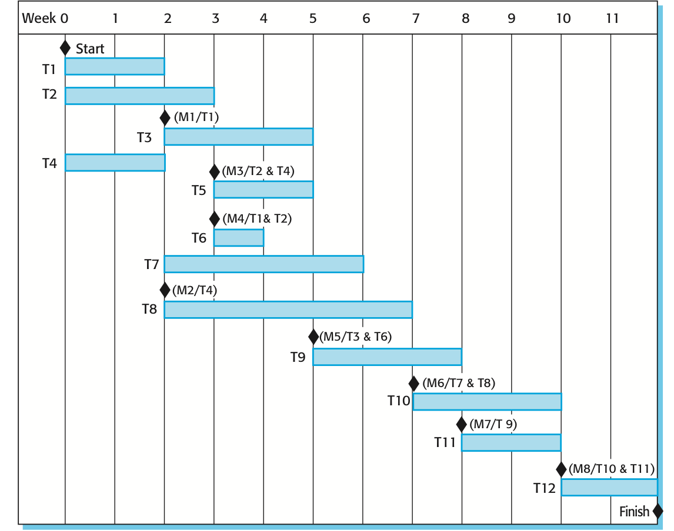

Slide 37
Estimation
Notes:
Start here

Slide 38
Project Effort Estimation
Units of effort = a + b (size)^{c} + Σ(factors)
Most of the estimating techniques use some form of this general formula
The most commonly used product attribute for cost estimation is code size.

Slide 39
Estimate Accuracy

Slide 40
COCOMO Estimation model
An empirical model based on project experience.
Steps
Select a project mode
Estimate the size of the project
Review cost-drivers to estimate the impact each will have on the project
Insert estimated values into effort formula for chosen mode

Slide 41
Lines of Code (LOC)
Lines of source code /programmer-months
Based on
Experience
Size of previous project
Size of competitor solution
Breaking down the project into smaller pieces and estimating each of the smaller pieces
Problems
Not a simple relationship between program statements and lines of code
Comparing across programming languages can be misleading

Slide 42
Function Points
Function points in a program are computed by measuring or estimating
External inputs
Eternal outputs
External inquiry
Internal logical files
External interface files
These various measurements are weighted based on their complexity
Productivity is measured by the number of function points per person-months
Notes:
start here

Slide 43
Function Point Weights
 | Simple | Average | Complex
Inputs | 3 | 4 | 6
Outputs | 4 | 5 | 7
Inquiries | 3 | 4 | 6
Files | 7 | 10 | 15
Interfaces | 5 | 7 | 10

Slide 44
OO Effort Estimation
Developed by Lorenz and Kidd for OO projects
Steps
Estimate the number of classes
Categorize the types of interfaces and assign a weight
Multiply classes by weight and add to original sum to get a new estimate of total classes
Multiply by a productivity estimate of number of person-days required to develop a class

Slide 45
Issues with Size Metrics
Ignore reuse, code generators and other tools
Quality is not considered

Slide 46
Risk Management

Slide 47
Risk management
Risk management is concerned with identifying risks and drawing up plans to minimize their effect on a project.
A risk is a probability that some adverse circumstance will occur
Project risks
Product risks
Business risks

Slide 48
The risk management process
Risk identification
Identify project, product and business risks
Risk analysis
Assess the likelihood and consequences of these risks
Risk planning
Draw up plans to avoid or minimize the effects of the risk
Risk monitoring
Monitor the risks throughout the project

Slide 49
Risk planning
Consider each risk and develop a strategy to manage that risk.
Avoidance strategies
Minimization strategies
Contingency plans

Slide 50
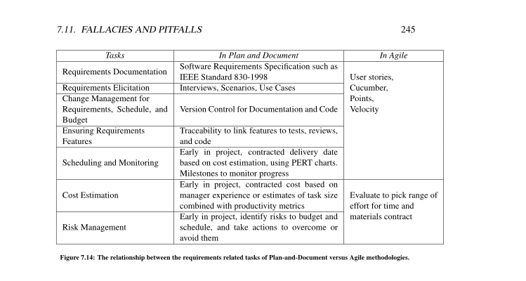
P and D vs. Agile Requirements and Schedule/Cost Estimation

